Slide 1

This PowerPoint is for use by UW in the High School teachers. Teachers can adapt this slideshow for communicating with parents and students about the program.
For more information or to schedule a presentation at your school, contact:
Tim Stetter, Program Manager tstetter@pce.uw.edu
206-221-6223

Slide 2

UW in the High School
Bringing the University
to Your Classroom

Slide 3
UW in the High School
Highly-qualified Teachers,
who are
UW-approved and supported,
UW Courses
teach
High School Students,
to
who can earn
UW Credits
alongside
Peers
Classrooms.
in their own

Slide 4

UW in the High School
 | Costs to student | Student stays at the high school | Student earns a grade and college credit through the whole course | Professional development for the high school teacher
Advanced Placement | Test: $87, Reduced fee for low-income students
Running Start | Books, transportation, prorated fees
UW in the High School | Course: $305 Registration: $39

Slide 5

UW in the High School
Benefits to Students
Engage in university-level
coursework
Establish a UW transcript
Gain access to the UW libraries
Earn a grade and college credit
throughout the course, not
on one high-stakes exam
Save money on college credits
Notes:
Student one-year out survey 2010: 92% of students (N=238) gave their overall experience with the program the grade of an A or B

Slide 6
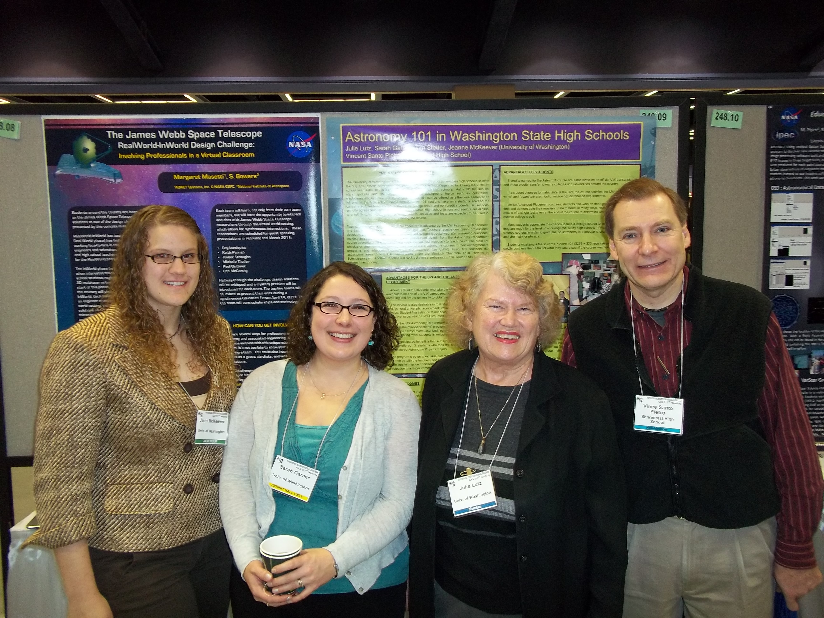
UW in the High School
Benefits to Teachers
Earn recognition as UW
Extension Lecturers
Access UW libraries and
departmental resources
Collaborate with UW Coordinators
and Liaisons on curriculum and
assessments
Participate in professional
development at UW
The UW Astronomy Department and a Washington State High School teacher present on the UWHS Astronomy course at the American Astronomical Society Conference, Seattle 2011
Notes:
Julie Lutz and Vince Santo Pietro, Shorecrest HS

Slide 7
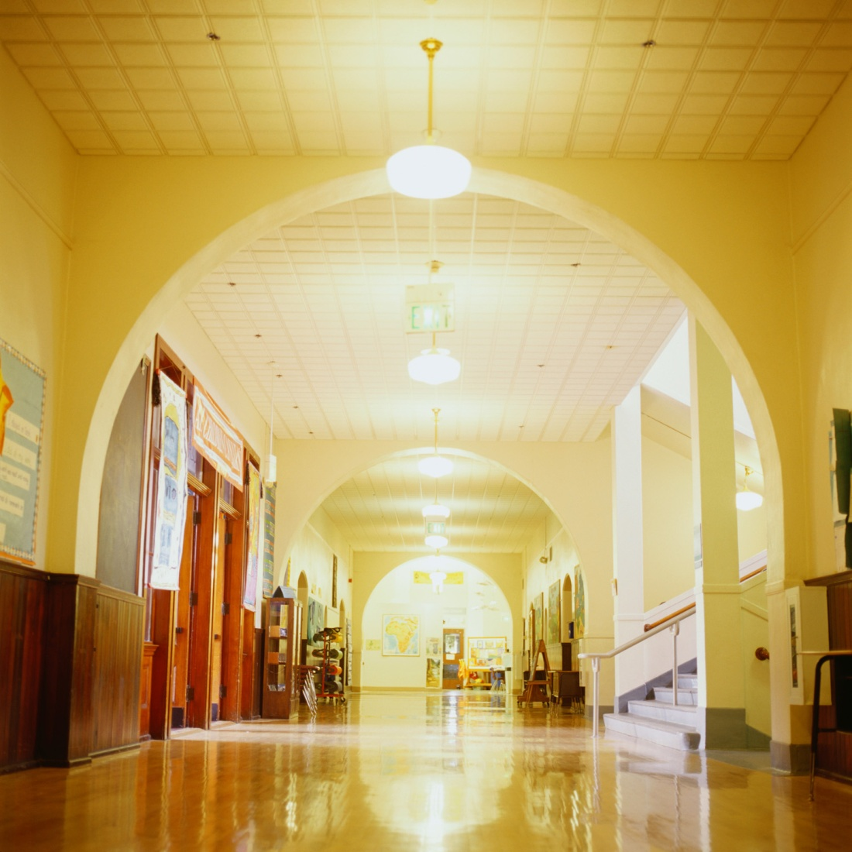
UW in the High School
Benefits to Schools
Retain students with on-
site college courses
Increase academic rigor
of course catalog
Become a recognized
partner of the University
of Washington

Slide 8

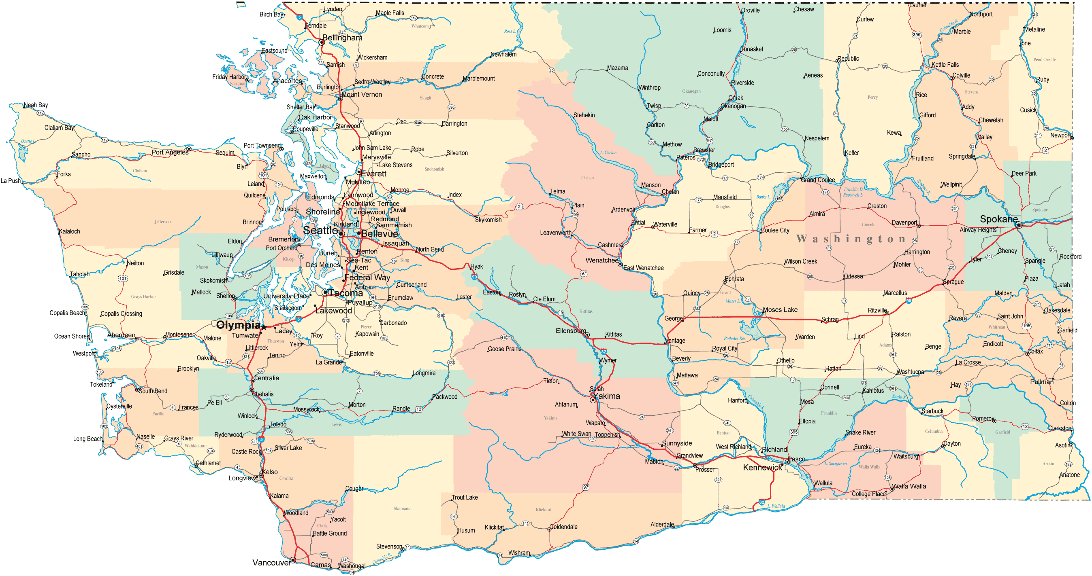
2010-11
2011-12
Lopez Island
Newport
Sequim
Chelan
Kennedy Catholic, Burien
Winlock
Hanford
72 schools 127 teachers 3,033 students
88
165
3,300
Notes:
A few news high schools represented here today: Tacoma School of the Arts, Sunnyside, Bainbridge Island, Suquamish Early College High School, and Hudson’s Bay in Vancouver

Slide 9
UW in the High School
World Languages
French 103, 201, & 202
German 103
Japanese 113 & 211
Spanish 103, 201, & 202
Notes:
Raise your hand: French, German, Spanish

Slide 10
UW in the High School
Humanities
English 111
Composition: Literature
English 131
Composition: Exposition
Comparative Literature 240
Comparative Literature
History 235
A History of the United States
Since 1940
Notes:
Raise your hand: French, German, Spanish

Slide 11
UW in the High School
Math and Computer Technology
Math 120
Precalculus
Math 124
Calculus I
Math 125
Calculus II
Math 126
Calculus III
Informatics 100
Fluency in
Information Technology
Computer Science 120
Computer Science Principles
Computer Science 142
Computer Programming I
Computer Science 143
Computer Programming II

Slide 12
UW in the High School
Science
Astronomy 101
Astronomy
Atmospheric Sciences 211
Climate and Climate Change
Biology 100
Addiction and the Brain
Earth & Space Sciences 101
Introduction to Geological Sciences
Oceanography 101
Survey of Washington Waters
Notes:
Raise your hand: Math, Astro, Ocean

Slide 13
UW in the High School
Courses Under Construction
Latin 103
Elementary Latin
Psychology 101
Introduction to Psychology
Chemistry 110
Introduction to General Chemistry
Environmental Science & Resource Management 100
Introduction to Environmental Science
UWHS
2012-13

Slide 14
UW in the High School
Grade Statistics *
Percentage Earned | Grade-Point Equivalent | Letter-Grade Equivalent
100-98 | 4.0 | A+
97-96 | 3.9 | A
95-94 | 3.8 | A
93-92 | 3.7 | A-
91 | 3.6 | A-
90-89 | 3.5 | B+
88-87 | 3.4 | B / B+
86 | 3.3 | B
85 | 3.2 | B
84 | 3.1 | B
83 | 3.0 | B / B-
82 | 2.9 | B-
81 | 2.8 | B-
80 | 2.7 | C / C+
79 | 2.6 | C
78 | 2.5 | C
77 | 2.4 | C
76 | 2.3 | C
75 | 2.2 | C
74 | 2.1 | C-
73 | 2.0 | C-
72 | 1.9 | C- / D+
71 | 1.8 | et cetera
Average Grade:
Percentage of grades >2.0:
* Grade statistics from 2008-09 school year
Total Number of Grades: 3,408
3.1
93%

Slide 15

Transferring Credit in Washington
UW in the High School
Generally DO Accept Credit:
Bellevue College
Central Washington University
Eastern Washington University
Evergreen State College
Gonzaga University
Pacific Lutheran University
Seattle Pacific University
Seattle University
Washington State University
Western Washington University
Whitworth University
All Community Colleges
Generally DON’T Accept Credit:
University of Puget Sound
Whitman College

Slide 16
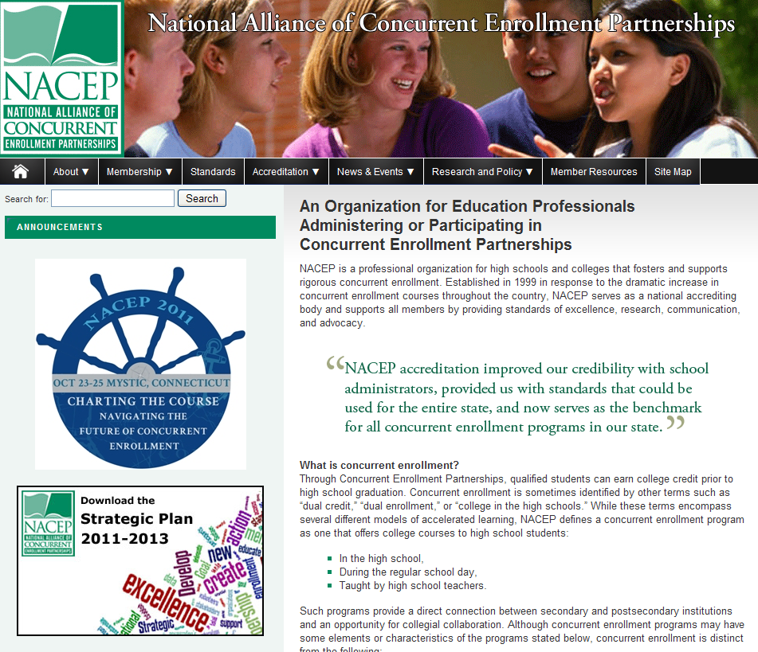

UW in the High School
Accreditation
www.nacep.org
NaCEP Conference
Seattle, October 2012

Slide 17
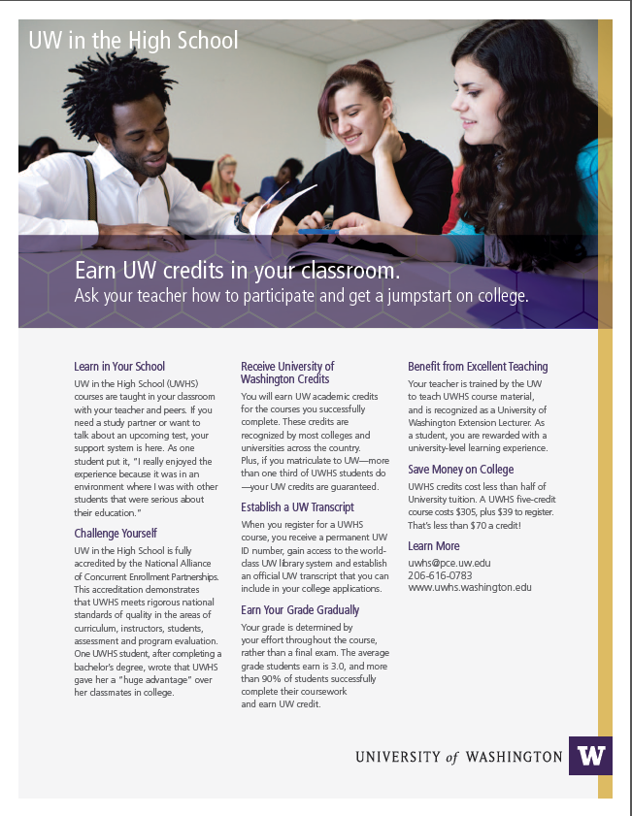
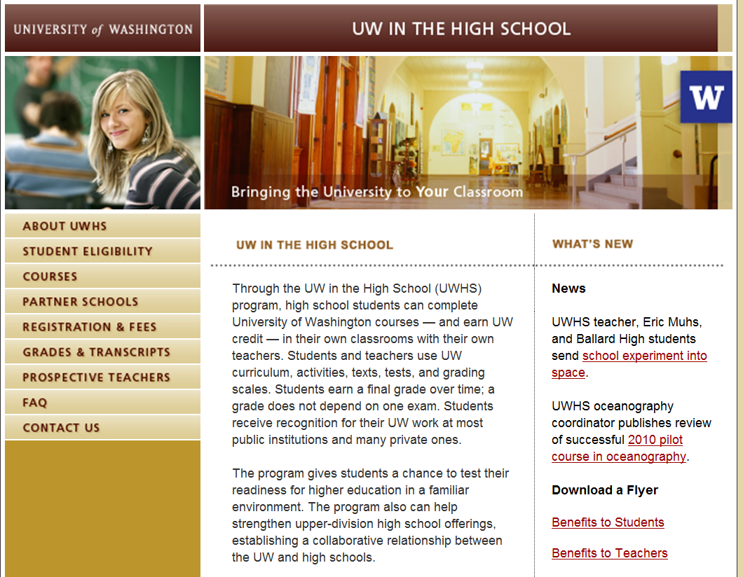
UW in the High School
UWHS Home Page
www.uwhs.washington.edu

Slide 18
UW in the High School
For more information, contact:
Tim Stetter
Program Manager
tstetter@pce.uw.edu
206-221-6223

